Slide 1
BUG TRACKING SYSTEM
Batch: WF8
Team Name: Code Minions

Slide 2
Project Scope
The project is an online bug tracking system for projects.
The application allows software testers to report bugs for a project, project managers to view all bugs, assign bugs to developers and developers to update the bug status.

Slide 3
Objectives
Identifying the bugs in the developed application.
Not merely identifying the bugs but also providing the bug information.
As soon as the bugs are identified, they are reported to the project manager by the testers and then assigned to the developer.
Project Manager ensures that all the bugs get resolved in the project.

Slide 4
Type of Users
Project Manager: View all bugs and Assign bugs to developers
Developer: Update the bug status
Tester: Report bugs for a project

Slide 5
Architectural Design
User
Bug Tracking System
Database
View Layer
Business Layer
Access Layer

Slide 6
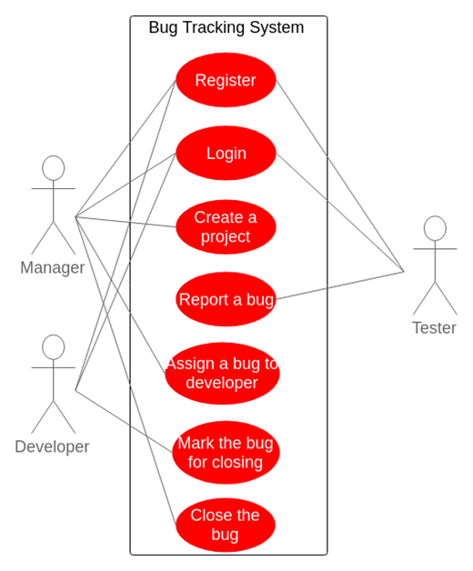
Use Case Diagram

Slide 7
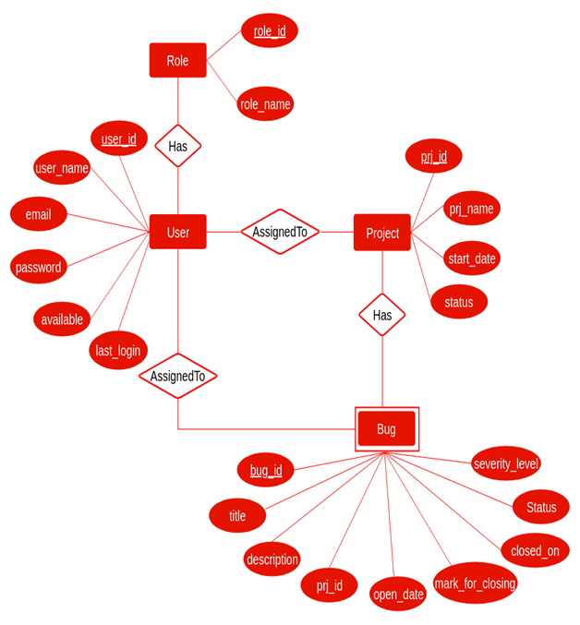
E R Diagram

Slide 8
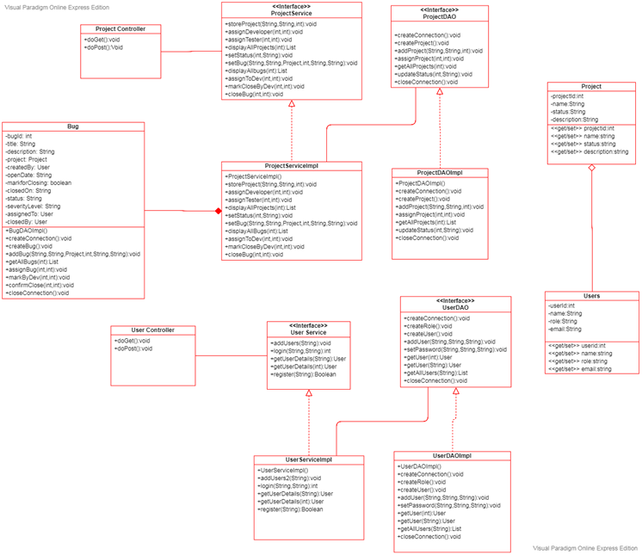
Class Diagram

Slide 10
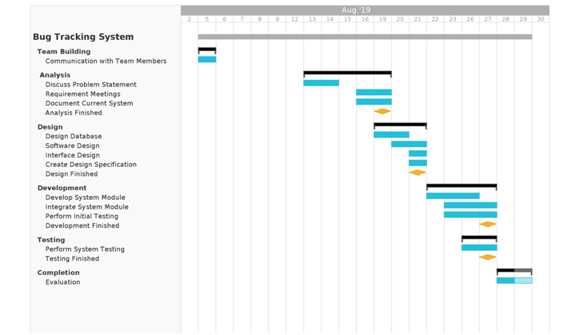
Gantt Chart

Slide 11
Key Features
Aspect-Oriented Project
Portable
Real Time Project
Maintains logs for logged in Users

Slide 12
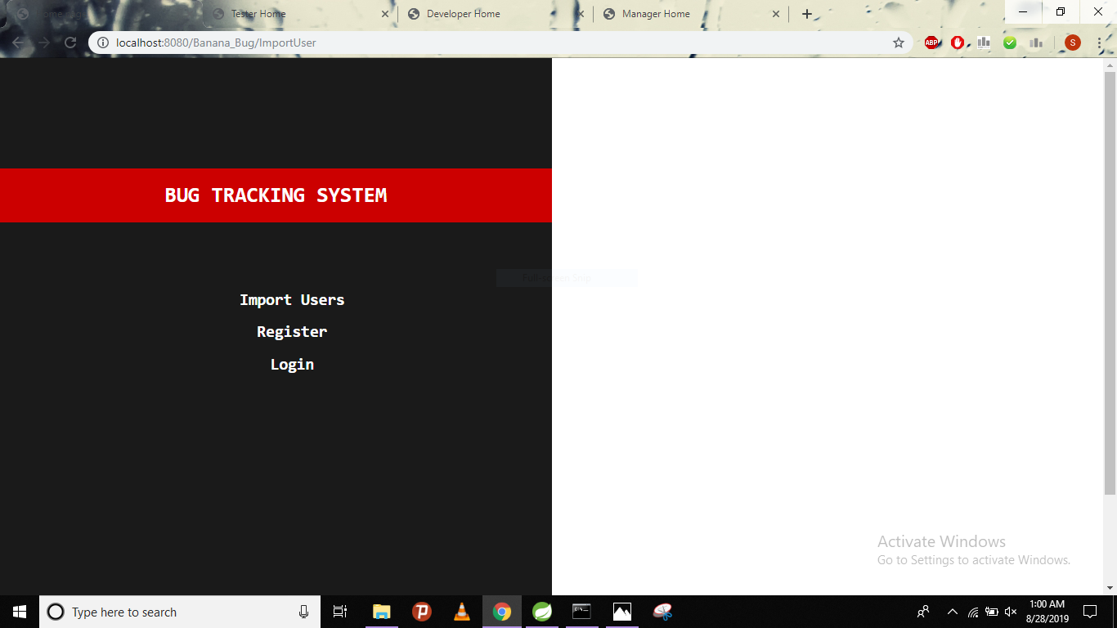
Screenshots

Slide 13
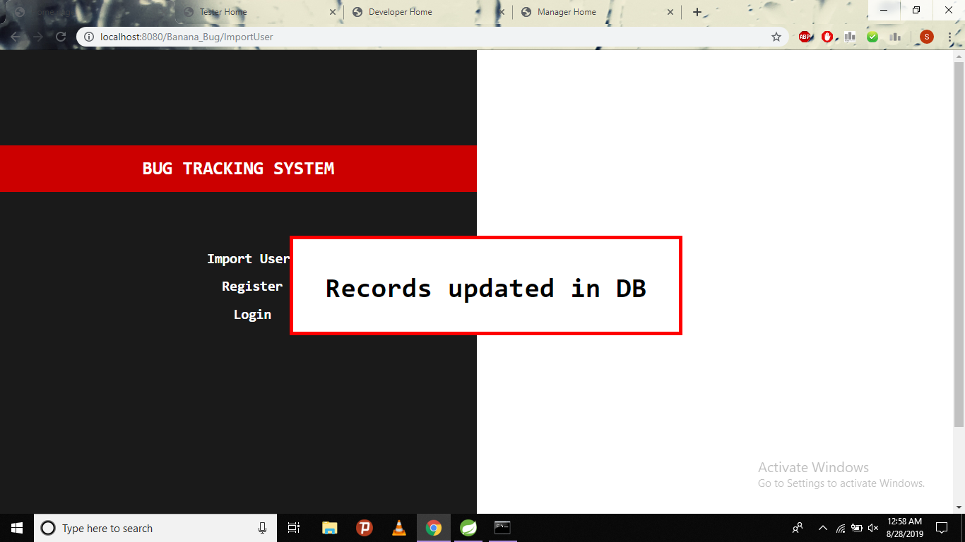

Slide 14
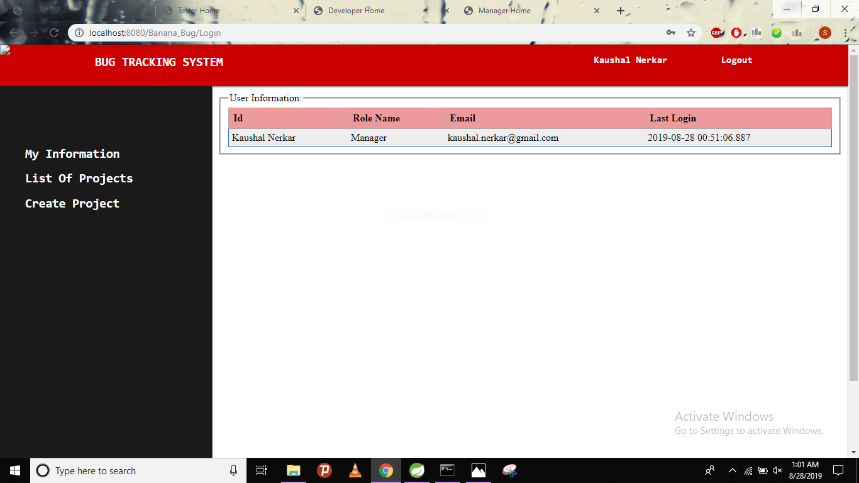

Slide 15
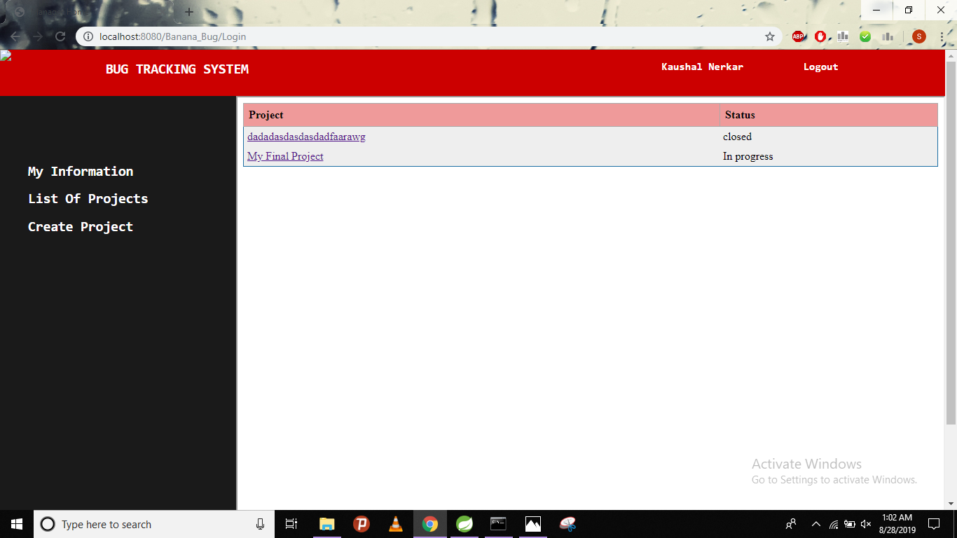

Slide 16
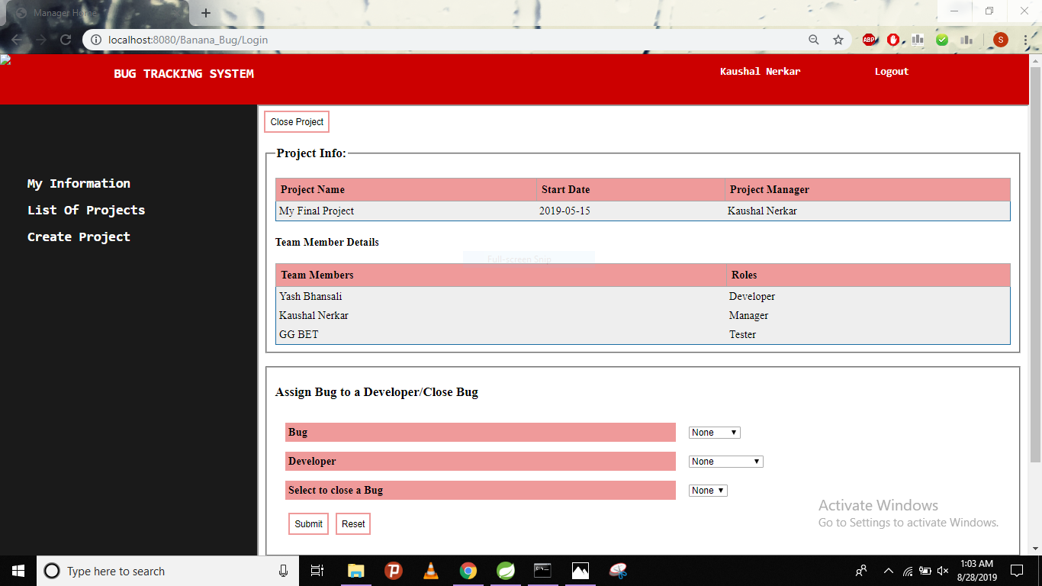

Slide 17
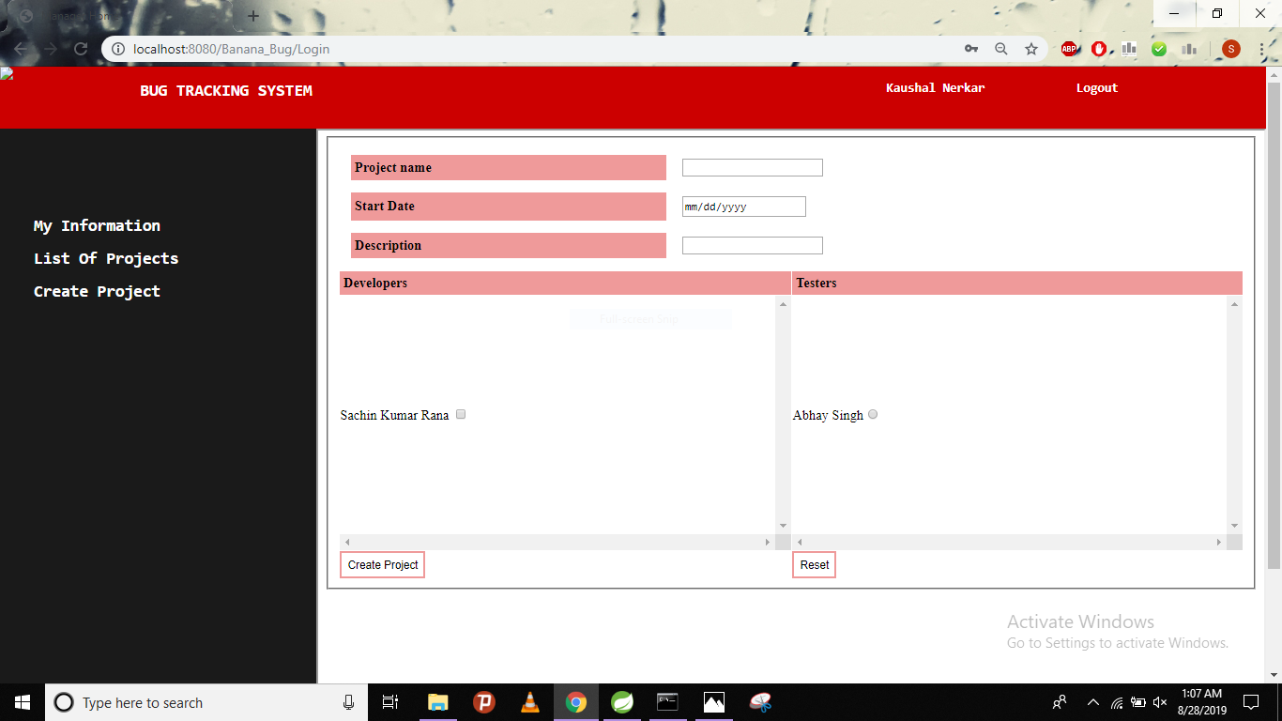

Slide 18
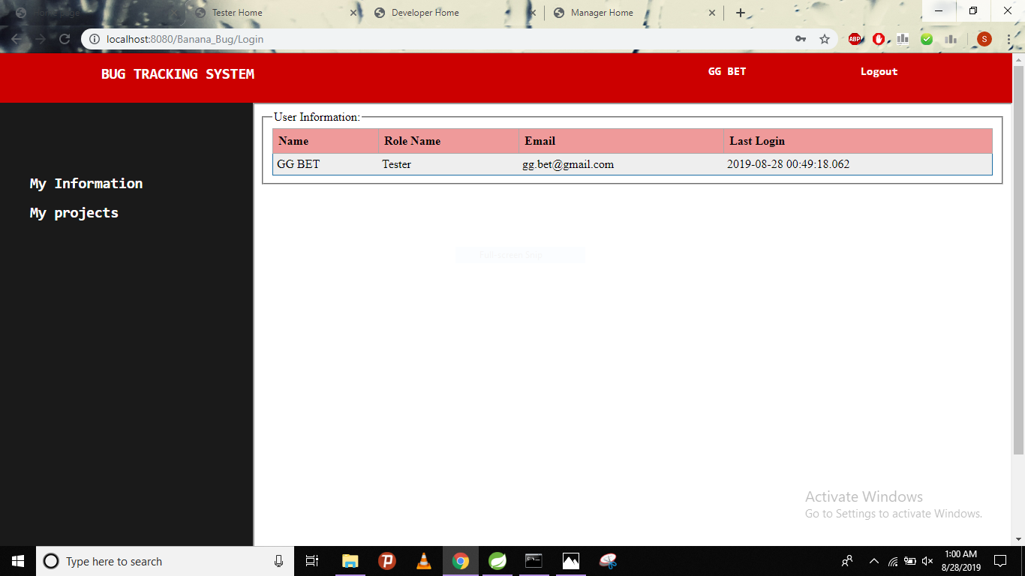

Slide 19


Slide 20
Conclusion
Bug Tracking System helps to detect and manage the bugs in software products effectively.
This project can be used to track the bugs in the project modules and assist in troubleshooting errors for testing and for development processes.
This project highly avoids all sources of delay in bugs reporting level within the project modules in the software industry. As application is deployed in a company server, it is much more secure.

Slide 21
Future Scope
This Bug Tracking System can be modified and enhanced for performing more complex task related to bug tracking system.
There are many more enhancements that are pending to make this project more interactive and professional, apart from this online facility, chat room, SMS alerts to the user and a separate account will be created for the testing team to compare severity of the incoming bugs.

Slide 22
Thank You

